Slide 1
BITS Pilani
Dr. Lavika Goel
Assistant Professor
Department of CSIS
Pilani Campus

Slide 2
Pilani Campus
Data Types

Slide 3
Agenda
Data Types
Primitive Data Types
Integer, Floats, Boolean, Char.
User defined ordinal types: Enumeration, subrange
Constructed types: Arrays, records.
Dangling pointers and memory leaks
Type checking
Pilani Campus

Slide 4
Data Types
•Types provide implicit context
•Compilers can infer information, so programmers write less code.
• e.g., The expression a+b in Java may be adding two integer, two floats or two strings depending on context
•Types provide a set of semantically valid operation
• Compilers can detect semantic mistakes
• e.g., Python’s list support append() and pop(), but not for complex numbers
Pilani Campus

Slide 5
What are types good for?
Error Detection (Reliability)
prevent errors caused by incompatible data
Abstraction (Writability)
support interfaces that hide implementation details
Efficiency (Runtime cost)
type information useful for compiler optimization
Pilani Campus

Slide 6
Types of languages
Strongly typed language: require the expected data type to match the formal data type as declared statically.
Example, Java, Python.
Weakly typed language: allows implicit type conversion or coercion.
Example, C.
Pilani Campus

Slide 7
Primitive vs. Constructed Types
Primitive type: basic type, it cannot be expressed in terms of other types
- Integer, char, float, Boolean, enumeration, subrange
Constructed type: Structured type, it is built from basic types.
- Arrays, records, pointers
Static Layout decisions: Occupy a fixed amount of space in the memory.
Pilani Campus

Slide 8
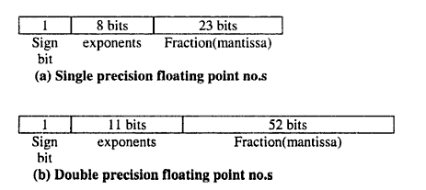
Primitive types
Integer & Floats:
Range
Unsigned (0-65535)
Signed (-32768 to +32767)
Operations
Arithmetic
Conditional
Logical
Float point numbers
Pilani Campus

Slide 9
Boolean
Introduced in ALGOL 60.
Could be implemented as bits, but often as bytes.
Advantage over say 1 and 0: readability
Pilani Campus
Notes:
A Boolean value could be represented by a single bit, but because a single bit of memory cannot be accessed efficiently on many machines, they are often stored in the smallest efficiently addressable cell of memory, typically a byte.

Slide 10
Character
Stored as numeric coding
Most commonly used coding: 8-bit ASCII
An alternative, 16-bit coding: Unicode
Includes characters from most natural languages
Originally used in Java
C# and JavaScript also support Unicode
Pilani Campus

Slide 11
User defined ordinal types
An ordinal type is one in which the range of possible values can be easily associated with the set of positive integers.
In Java, primitive ordinal types are integer, char and boolean.
There are two user defined ordinal types: enumeration and subrange.
Pilani Campus

Slide 12
Enumeration types
All possible values, which are named constants, are provided in the definition
C++ example:
enum colors {red, blue, green, yellow, black};
colors myColor = blue, yourColor = red;
myColor++ ; //possible
myColor = 4; //not possible, only possible in case the right side had been cast to colors type.
Pilani Campus

Slide 13
Subrange Types
Introduced in Pascal and used in Ada.
A contiguous subsequence of an ordinal type.
Example: 12..18 is a subrange of integer type.
Ada’s design:
type Days is (mon, tue, wed, thu, fri, sat, sun);
subtype Weekdays is Days range mon..fri;
Day1: Days;
Day2: Weekday;
Day2:= Day1; //the assignment is legal unless the value of Day1 is Sat or Sun
Pilani Campus
Notes:
Subrange types were introduced by Pascal and are included in Ada.

Slide 14
Constructed types: Array types
An array is a homogeneous aggregate of data elements in which an individual element is identified by its position in the aggregate, relative to the first element.
The individual data elements of an array are of the same type.
References to individual array elements are specified using subscript expressions.
Pilani Campus

Slide 15
Arrays and indices
Indexing (or subscripting) is a mapping from indices to elements
array_name (index_value_list) → an element
Pilani Campus

Slide 16
Subscript bindings and Array categories
Static: subscript ranges are statically bound and storage allocation is static (before run-time)
Advantage: efficiency (no dynamic allocation)
Fixed stack-dynamic: subscript ranges are statically bound, but the allocation is done at declaration time during execution
Advantage: space efficiency
Stack-dynamic: subscript ranges are dynamically bound and the storage allocation is dynamic (done at run-time)
Advantage: flexibility (the size of an array need not be known until the array is to be used)
Pilani Campus

Slide 17
Subscript bindings and Array categories
Fixed heap-dynamic: similar to fixed stack-dynamic: storage binding is dynamic but fixed after allocation (i.e., binding is done when requested and storage is allocated from heap, not stack)
Advantage: flexibility (the array’s size always fits the problem)
Heap-dynamic: binding of subscript ranges and storage allocation is dynamic and can change any number of times
Advantage: flexibility (arrays can grow or shrink during program execution)
Pilani Campus

Slide 18
Subscript bindings and Array categories
C and C++ arrays that include static modifier are static
C and C++ arrays without static modifier are fixed stack-dynamic
C and C++ provide fixed heap-dynamic arrays using standard C library functions malloc, free (C) and new, delete (C++).
Pilani Campus

Slide 19
Array Initialization
Some language allow initialization at the time of storage allocation
C, C++, Java, C# example
int list [] = {4, 5, 7, 83}
Character strings in C and C++
char name [] = “freddie”;
Arrays of strings in C and C++
char *names [] = {“Bob”, “Jake”, “Joe”};
Pilani Campus

Slide 20
Implementation of Array types
Implementing arrays requires considerably more compile-time effort than does implementing primitive types.
A single-dimensioned array is implemented as a list of adjacent memory cells.
address(list[k]) = address(list[lower_bound]) +
((k - lower_bound) * element_size)
Pilani Campus

Slide 21
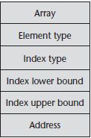
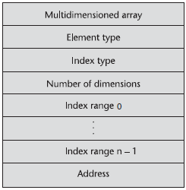
Implementation of Array types
Compile-time descriptor for single-dimensioned arrays.
Row major order : used in most languages
Column major order: used in Fortran
Pilani Campus

Slide 22
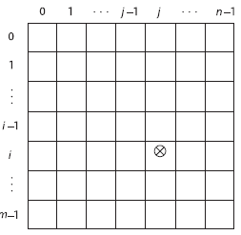
(Contd..)
The location of the [i,j] element in a matrix
Row major form:
location(a[i,j]) = address of a[0, 0]
+ ((((number of rows above the ith row) * (size of a row))
+ (number of elements left of the jth column)) * element size)
location(a[i, j]) = address of a[0, 0] + (((i * n) + j) * element_size)
where n is the number of elements per row. The first term is the constant part
and the last is the variable part.
Pilani Campus

Slide 23
(Contd..)
location(a[i, j]) = address of a[row_lb, col_lb] + ((((i-row_lb) * n) + (j-col_lb)) * element_size)
= address of a[row_lb, col_lb] – (((row_lb * n) + col_lb)* element_size) + (((i*n)+j) * element_size)
Pilani Campus

Slide 24
Record Types
A record is a possibly heterogeneous aggregate of data elements in which the individual elements are identified by names.
In C, C++, and C#, records are supported with the struct data type.
The fundamental difference between a record and an array is that record elements, or fields, are not referenced by indices.
Most languages use dot notation for field references; for example:
Employee_Record.Employee_Name
Pilani Campus

Slide 25
Records
A record type with k fields is of the form:
record
<name1>: <type1>;
<name2>: <type2>;
…
<namek>: <typek>;
end
Example:
type complex = record
re: real;
im: real;
end;
type complex = record
re, im: real;
end;
A change in the order of fields of a record has no effect on the meaning of a program as the fields are accessed by name, not by relative position in the array.
Pilani Campus

Slide 26
Storage allocation in records
Variable declaration allocates storage.
Record type complex is a template for 2 fields re and im. Storage is allocated when the template is applied in a variable declaration.
Example: var x,y,z: complex;
Variables x, y and z have storage allocated with them, the layout of this storage is determined by the type complex.
Pilani Campus

Slide 27
Operations on records
If expression E denotes a record with a field named f, then the field is denoted by E.f which has both a location and value.
z.re = x.re + y.re // the sum of the values of the fields x.re and y.re is placed in the location of z.re
Record assignment:
All the fields of a record can be assigned component-wise, example, x = y;
This assignment sets x.re to y.re and x.im to y.im
Pilani Campus

Slide 28
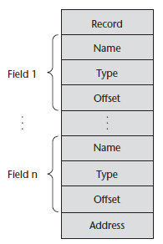
A compile-time descriptor for a record
Pilani Campus

Slide 29
Comparison of Arrays and Records
More flexibility in selecting the array elements than the record fields as the array element A[i] can change at run-time but the record field E.f is fixed at compile-time.
More flexibility in choosing the field types than array elements as the fields of a record can have different types but all array elements must have the same type.
Pilani Campus

Slide 30
Comparison of Arrays and Records
Component types: Arrays are homogeneous collection of data elements whereas records are heterogeneous collection of elements.
Component selectors: In arrays, the type of A[i] is known at compile-time even though the actual element is known at run-time. In records, names are known at compile-time so the type of the selected component is also known at compile-time.
Pilani Campus

Slide 31
Comparison
 | Arrays | Records
Access | Indexed | Named
Data type | Homogeneous | Heterogeneous
Layout | Compile-time | Compile-time
Memory Allocation | Run-time, all elements occupy same amount of space and stored in consecutive memory locations. | Run-time, each field can occupy a different amount of space.
Type expression | <Array, Data type, size> | < Cartesian product of Ist field X 2nd field X 3rd field X..> i.e. <T1 X T2 X T3….Tn>
Pilani Campus

Slide 32
Evaluation and Comparison to Arrays
Arrays are used when all the data values have the same type and/or are processed in the same way.
Records are used when collection of data values is heterogeneous and the different fields are not processed in the same way.
Access to array elements is much slower than access to record fields, because subscripts are dynamic (field names are static)
Pilani Campus

Slide 33
Variant records
Records are used for representing objects with common properties. All records of the same type have the same fields.
Variant records are used for representing objects that have some but not all properties in common.
Variant records have a part common to all records of that type, and a variant part specific to some subset of the records.
Union is a special case of a variant record with no common fields.
Pilani Campus

Slide 34
Layout of a variant record
Layout of variant records for an expression tree.
Nodes can be classified into variables, constants, binary operators and unary operators.
All nodes can have some common properties, but they have different no. of children.
Nodes for variables and constants have no children, nodes for binary operators
have 2 children and nodes for unary operators have 1 child.
Pilani Campus

Slide 35
VARIANT RECORDS
Layout of Variant Records
1. Fixed Part: consisting of common fields
2. Tag Field: optional, used to distinguish between variants.
3. Variant Part: corresponds to nodes with 0, 1 or 2 children.
Pilani Campus

Slide 36
Syntax of variant record
case <tag-name> : <type-name> of
<constant1>: (<fields1>);
<constant2>: (<fields2>);
….
<constantv>: (<fieldsv>);
The constants correspond to distinct states of the variant part, each state has its own field layout.
The state depends upon the constant stored in the tag field.
The space reserved for a variant part is just enough to hold the fields in the largest variant.
Pilani Campus

Slide 37
Example
type kind = {leaf, unary, binary};
node = record
c1: T1;
c2: T2;
case k: kind of
leaf: ();
unary: (child: T3);
binary: (lchild, rchild: T4);
end;
Variant part of node has 3 distinct field layouts for leaf, unary and binary.
Pilani Campus

Slide 38
Variant records and type safety
Variant records compromise type safety.
Compilers cannot check whether the value in the tag field is consistent with the state of the record.
Tag fields are optional.
Since there is no tag field, the state of the variant part cannot be stored within the record.
Example:
type kind = 1, 2;
t = record
case kind of
1: (i: integer);
2: (r: real);
end;
var x : t;
Errors go undetected: x.r = 1.0; writeln(x.i);
Pilani Campus

Slide 39
Unions
A union is a type whose variables are allowed to store different type values at different times during execution.
Design issues
Type checking.
Pilani Campus

Slide 40
(contd..)
Fixed sized records can be type checked at compile-time.
Variant sized records can be type checked at run time (Tagged Unions).
Unions cannot be type checked at both compile time and run time.
Pilani Campus

Slide 41
Pointers
A pointer type variable has a range of values that consists of memory addresses and a special value, nil.
Provide the power of indirect addressing.
Pointers have a fixed size independent of what they point to. They typically fit into a single machine location.
Provide a way to manage dynamic memory.
A pointer can be used to access a location in the area where storage is dynamically created (usually called a heap).
Pilani Campus

Slide 42
Pointer Operations
Two fundamental operations: assignment and dereferencing.
Assignment is used to set a pointer variable’s value to some useful address.
Dereferencing yields the value stored at the location represented by the pointer’s value.
Dereferencing can be explicit or implicit.
C++ uses an explicit operation via *:
j = *ptr sets j to the value located at ptr
Pilani Campus

Slide 43
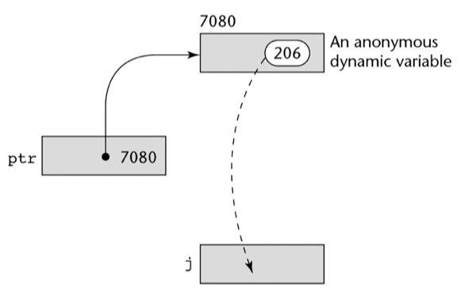
Pointer Assignment Illustrated
Pilani Campus

Slide 44
Pointers in C and C++
Extremely flexible but must be used with care.
Pointers can point at any variable regardless of when or where it was allocated.
Used for dynamic storage management and addressing.
Pointer arithmetic is possible.
Explicit dereferencing and address-of operators.
Pilani Campus

Slide 45
Pointers in C and C++
The asterisk (*) denotes the dereferencing operation.
The ampersand (&) denotes the operator for producing the address of a variable.
int *ptr;
int count, init;
……
ptr = &init; //address
count = *ptr; //value
Pilani Campus

Slide 46
(contd..)
ptr + index;
int list [10];
int *ptr;
ptr = list; //assigns the address of list[0] to ptr
*(ptr+1) is equivalent to list[1]
*(ptr+index) is equivalent to list[index]
ptr[index] is equivalent to list[index]
Pilani Campus

Slide 47
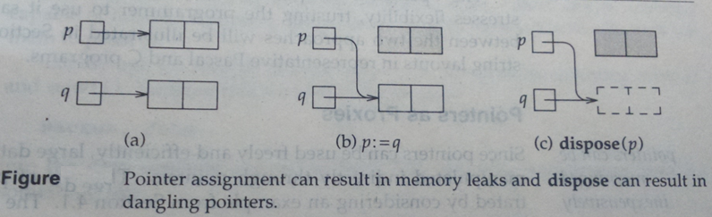
Problems with pointers
Dangling Pointers: is a pointer to a storage which has been already de-allocated. Operation dispose(p) leaves the pointer ‘p’ dangling.
Memory Leaks: Storage that is allocated but is inaccessible is called garbage. Programs that create garbage are said to have memory leak.
Pilani Campus

Slide 48
Example
main() { struct node {
int a ;
struct node *next;
}
node *p, *q, *r, *s;
p = (node *) malloc(sizeof(node)); q = (node *) malloc(10*sizeof(node)); r = (node *) malloc(18*sizeof(node)); s = (node *) malloc(25*sizeof(node)); r->next = p; q->next = s; s = r; q = p; free(r->next); }
Memory Leak ->
directly --> 10*sizeof(node) = 10* 8 =80 bytes
indirectly --> 25*sizeof(node) = (25 * 8) bytes
Dangling Pointer (in the end): p, q , r->next
Pilani Campus

Slide 49
Example
main()
{
int A[10]={10,12, 9, 1, 2, 45, 9, 12, 99, 10};
int *z, *ptr; int x,y;
ptr= function1(A, z);
x = *z; [pointer z is a dangling pointer so when x tries to dereference z, output is segmentation fault or corrupt value.]
y = *ptr; // What is the value of y?
}
int *function1(int B[10], int *p)
{
int *q;
int y = 5;
p = &y;
q = &B[5];
return q;
}
Pilani Campus

Slide 50

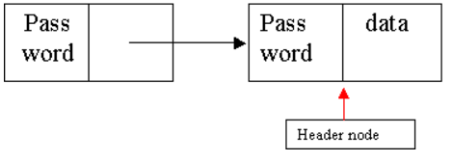
Solutions to Dangling pointers
· Tombstone approach - allocate extra storage cell to point to block of storage. Every pointer points to a tombstone
(special cell) which points to the actual storage.
To remove dangling reference, de-allocate storage and set "tombstone" to nil.
Any access to storage will lead to run-time error.
Advantage-prohibits access to obsolete data (deallocated storage).
. Lock and keys approach-
Pointers are represented as a pair (key, address) and storage as (lock, value).
2 passwords (lock and key of pointer and storage respectively) must match in order to access data
else leads to run-time error.
Pilani Campus

Slide 51
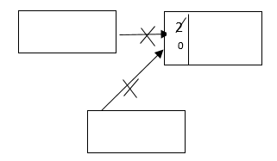
Garbage collection methods
Reference counting approach- maintains a counter in every storage that stores the no. of pointers that are currently pointing to the storage. Program waits until reference count is 0 before memory is returned to heap.
Cannot detect cyclic structures.
Mark and sweep approach-
Initially all storage in heap have their check bit set to garbage.
When free space becomes exhausted, mark active storage as live (using check bit).
Active storage are those which are reachable by chain of pointers that originates from outside
the heap (i.e., from a pointer currently on the stack or from a global variable)
For each pointer outside the heap do a depth-first search using recursion.
Storage in heap which is not active is garbage and it is returned to free space.
Advantage: Can detect cyclic structures and recover space
Pilani Campus

Slide 52
(Contd..)
Stop and copy approach:
It divides the memory into two halves of equal size and does all its allocation in one half.
When the half is full, the collector starts its exploration of reachable storage (using depth first search and recursion). Each reachable block of storage is copied into the second half of the heap.
The first half of the memory, is reclaimed after resetting the pointers of copied storage in the first half to point to the new location.
Now, any pointer that refers to the same storage will point to the new location.
Advantage: Eliminates memory fragmentation by using compaction.
Pilani Campus

Slide 53
Type Checking
Type checking is the activity of ensuring that the operands of an operator are of compatible types.
A type error is the application of an operator to an operand of an inappropriate type.
Pilani Campus

Slide 54
Binding
(Association)
Binding of a variable (identifier) with its type: Compile time.
Binding of a variable (identifier) with its value: Run-time, value of variable can change at run-time.
Binding of a variable (identifier) with its location (relative address): compile-time
Binding of relative address with physical address: run-time: Logical memory to physical memory address conversion is a run-time issue, actual memory location is known at run-time.
Pilani Campus

Slide 55
Static and dynamic type binding
Dynamic type binding:
Type of a variable is not specified in a declaration statement instead the variable is bound to its type when it is assigned a value in an assignment statement.
This assignment also binds the variable to an address in the memory because different type of variables require different storage space.
Variable’s type can change any no. of times during program execution.
Static type binding:
Type of a variable and its address is bound at compile-time.
Pilani Campus

Slide 56
Types of type checking
Static type checking: is done when binding of variables to types is done at compile time (static binding or early binding).
Dynamic type checking: is done when binding of variables to types is done at run-time (dynamic binding or late binding).
Static checking is better as the earlier the errors are detected, the less costly the correction of error is.
Type checking is complicated when a language allows a memory cell to store values of different types at execution. Example, in case of memory cells created by variant records.
Pilani Campus

Slide 57
Types of languages
Strongly typed language: A programming language is strongly typed if type errors are always detected.
Example, Java, Python.
Weakly typed language: allows implicit type conversion or coercion, error detection capabilities may be weaker.
Coercion is a conversion from one type to another inserted automatically by a programming language. i.e. 2*3.14 is coerced to 2.0 * 3.14
Example, C, C++ (allow unions which cannot be type checked)
Pilani Campus

Slide 58
Type Equivalence
Type equivalence is checking type compatibility between operands of operators without allowing coercion.
Type Equivalence is defined in terms of structural and name equivalence.
Name type equivalence: Two variables have equivalent name types if they are defined either in the same declaration or in declaration that use the same type name.
Structure type equivalence: Two variables have equivalent structure types if their types have identical structures.
Pilani Campus

Slide 59
Example of name & structural equivalence
struct complex
{
float re,im;
};
struct {
float re,im;
}a,b;
struct complex c,d;
struct polar e;
struct polar
{
float x,y;
};
Name equivalence: Two types are same under name equivalence when they share the type name(ex. c,d)
Structural equivalence: Two types are same under structural equivalence when they have same structure(ex. a,b,c,d)
Are d and e name equivalent?
No
Pilani Campus

Slide 60
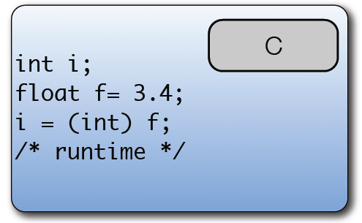
Type Conversion
• A value of one type can be used in a context of another type using type conversion or type cast.
• Under a converting type cast, the underlying bits are
changed
Pilani Campus

Slide 61
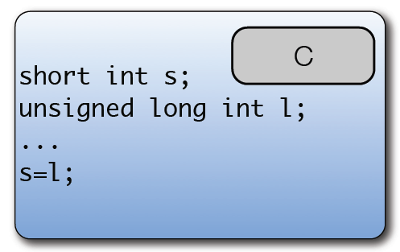
(Contd..)
• Type coercion allows a value of one type to be used in
a context that expects another.
This makes the system type weaker.
Pilani Campus

Slide 62
Summary
The primitive data types of most imperative languages include numeric, character, and Boolean types. The numeric types are often directly supported by hardware.
The Complex data types like arrays, records are based on primitive data types and while designing them we are mainly concerned about the access methods to retrieve the individual elements.
Pointer types pose serious problems.
Type check is the only way to avoid error with respect to data types.
Pilani Campus

